Slide 1
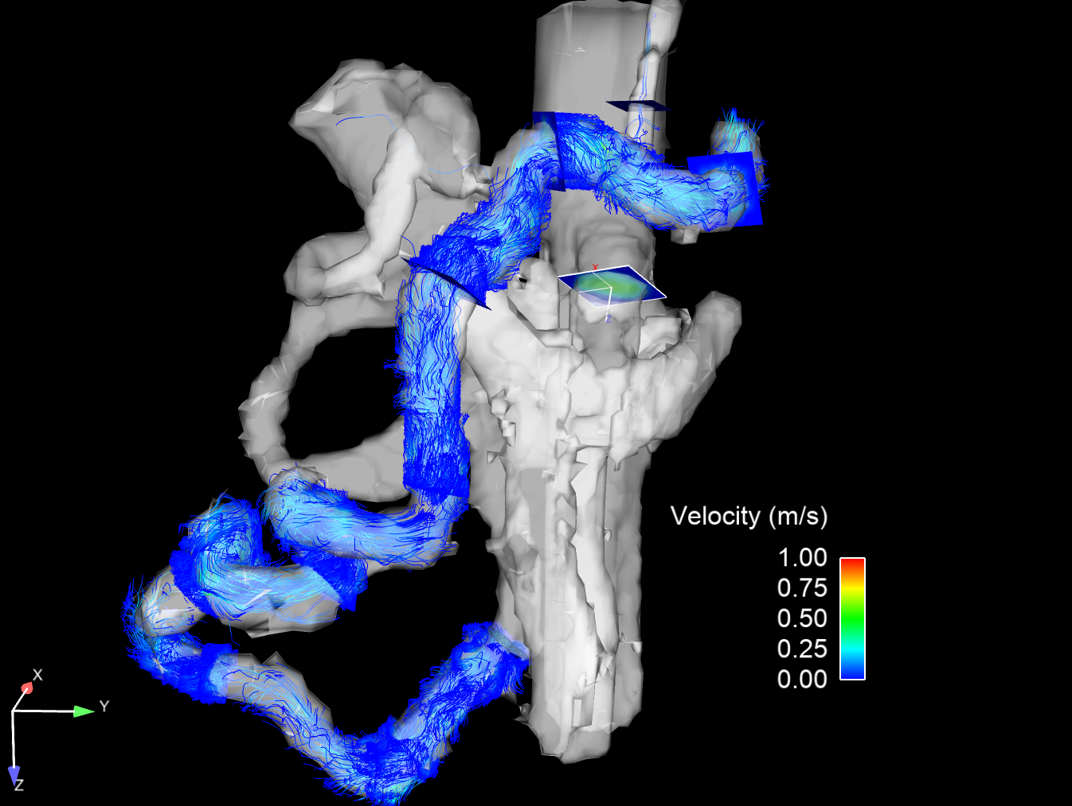
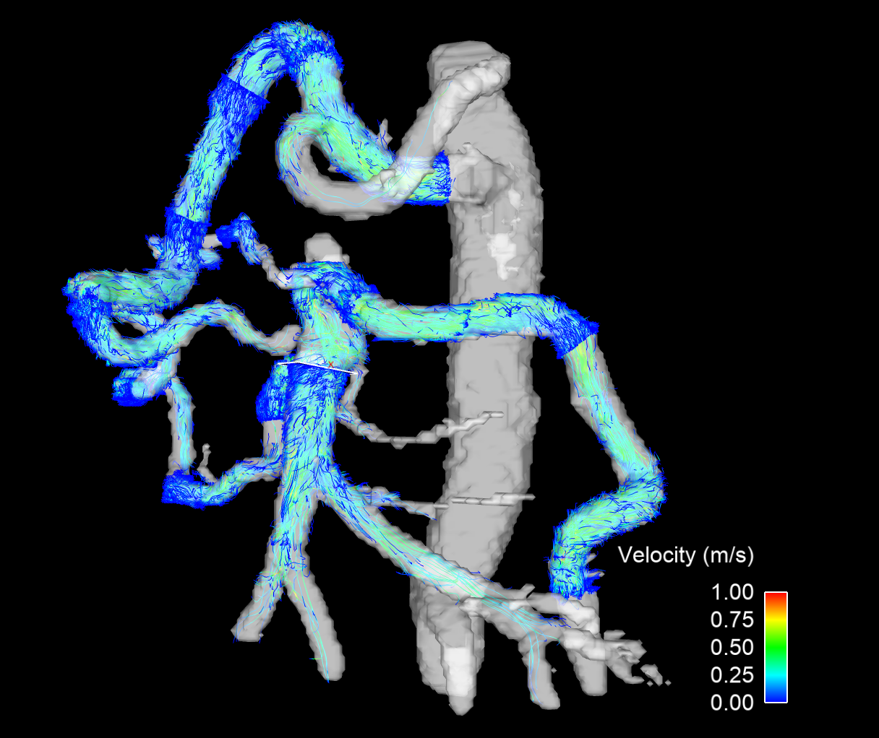
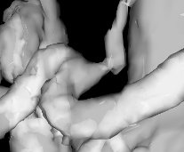
Left gastric artery
GDA
CA compression
Splenic artery
Pancreaticoduodenal arcades
SMA

